Slide 1
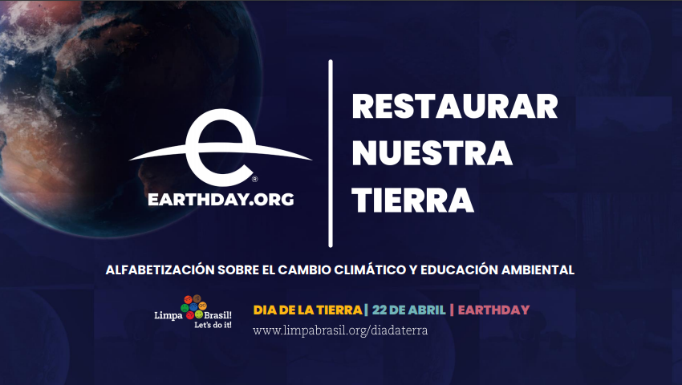
EARTHDAY SOUTH AMERICA 2021

